Slide 1
CSS - flexbox (Day 3)
Viktoras Lava www.viktoraslava.lt

Slide 2
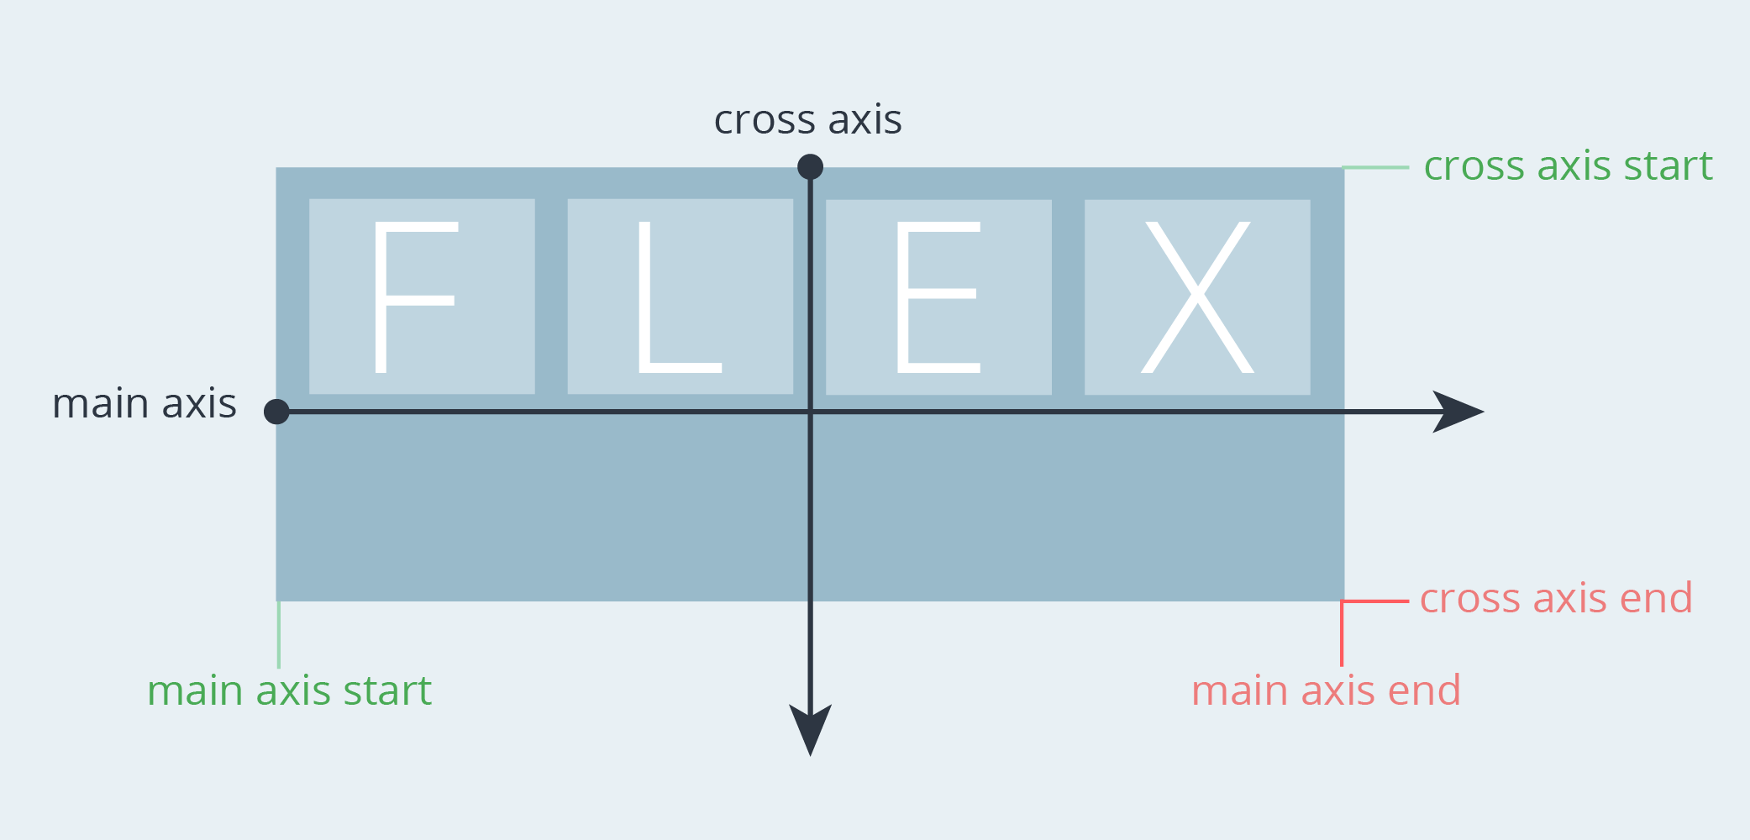
Flexbox
Flexbox was created to provide a more efficient way to lay out, align and space items in the container, even when their size is unkown.
Flex tries to alter items
width / height to best fill the available space.

Slide 3
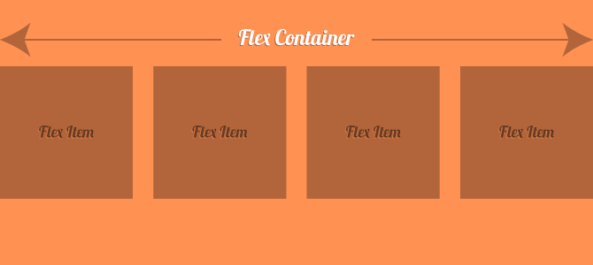
Flex container’s properties
If you want to define a flex container you can do so with display: flex rule. This rule will enable flex context for all it’s direct children. Some of the possible properties:
flex-direction
flex-wrap
justify-content
align-items
align-content

Slide 4
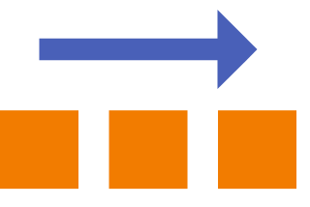
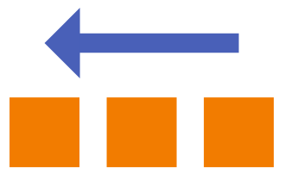
Flex-direction - example 1
flex-direction: row (default)
flex-direction: row-reverse

Slide 5


Flex-direction - example 2
flex-direction: column
flex-direction: column-reverse

Slide 6
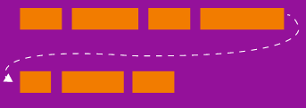
Flex-wrap
By default flex items will try to fit in one line, however you can turn this ability off. Possible properties:
nowrap (default)
wrap
wrap-reverse
Example

Slide 7
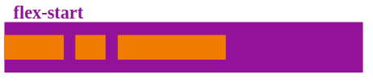

Justify-content
Positions children elements on the main axis (x axis). Possible properties:
flex-start (default)
flex-end
center
space-around
space-between

Slide 8

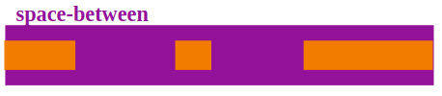

Justify-content - example

Slide 9
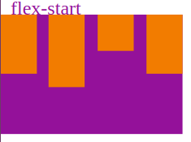
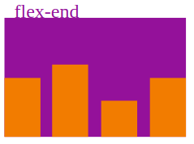
Align-items
Positions children elements on the cross axis (y axis). Possible properties:
flex-start (default)
flex-end
center
stretch
baseline

Slide 10
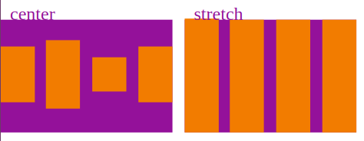
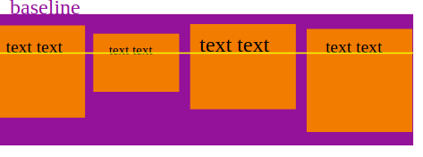
Align-items - example

Slide 11
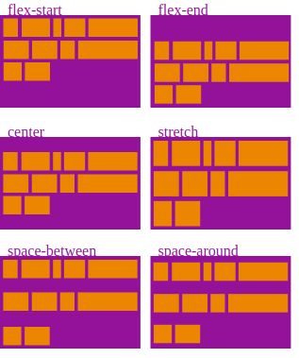
Align-content
Positions children elements on the cross axis (y axis), when there is extra space in y axis, works only when there’s more than one line.
flex-start
flex-end
center
stretch (default)
space-between
Space-around
Example

Slide 12
Questions?

